Slide 1
Manage relationships
Manage relationships

Slide 2
Manage Relationship
Note: This Lab uses lab1.xlsx in Sales Model

Slide 3
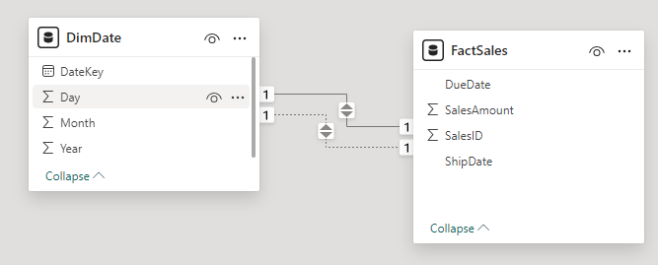
Manage Relationship
Note: This Lab uses lab1.xlsx in Sales Model
Go to Model interface and create the following relationships
FactSales[DueDate] → DimDate[DateKey] (Set as Active).
FactSales[ShipDate] → DimDate[DateKey] (Set as Inactive).

Slide 4
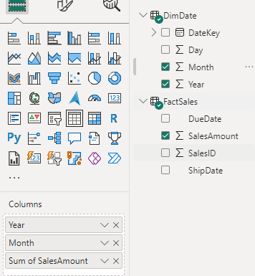
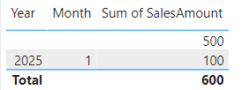
Manage Relationship
Create a Table Visual:
Add DimDate[Year], DimDate[Month], and FactSales[SalesAmount].
Observe that only the active relationship (DueDate) will be reflected in the visual.
Sales data will aggregate based on DueDate.

Slide 5
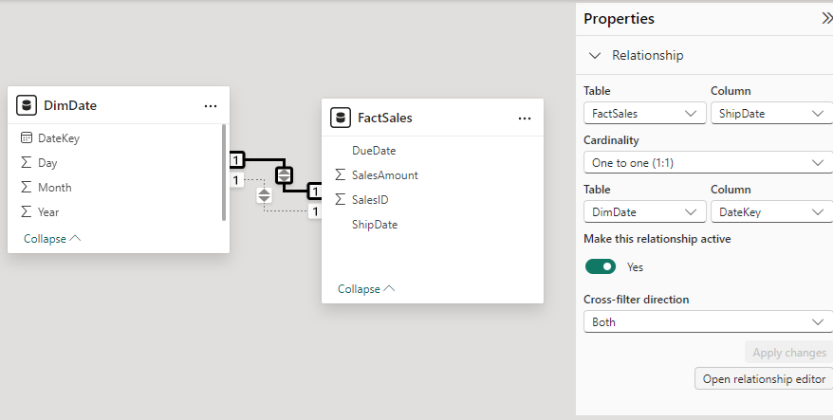
Manage Relationship
Go to Manage Relationships and click the button

Slide 6
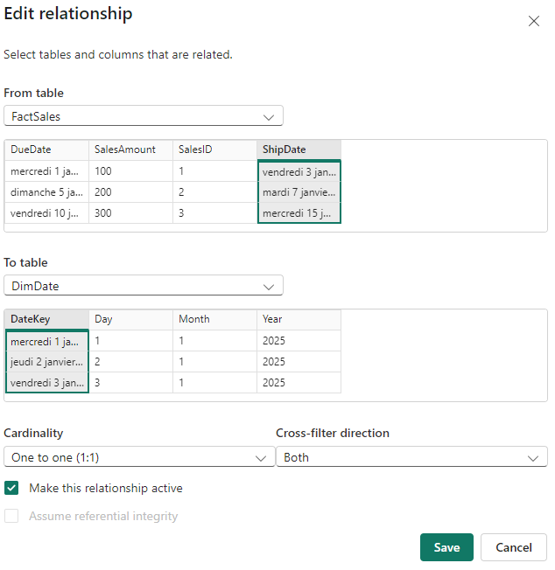
Manage Relationship
Set FactSales[DueDate] → DimDate[DateKey] as Inactive and set FactSales[ShipDate] → DimDate[DateKey] as Active

Slide 7
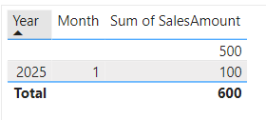
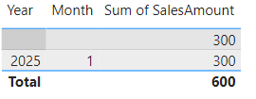
Manage Relationship
Note that the data changes at the visual Level
Due date
Ship date

Slide 8
Thank you
Thank you

